Slide 1






FB Ads Analysis
By FUN 5: Apoorva Srinivas, Kushall Dayal, Mapeishi Dai, Prerana Patil, Xiufeng (Andrew) Huang

Slide 2
Agenda
Introduction: Company, Data Set, Project Objectives
Web Analytics
Regression Analysis
Limitations, Recommendations & Next Steps

Slide 3
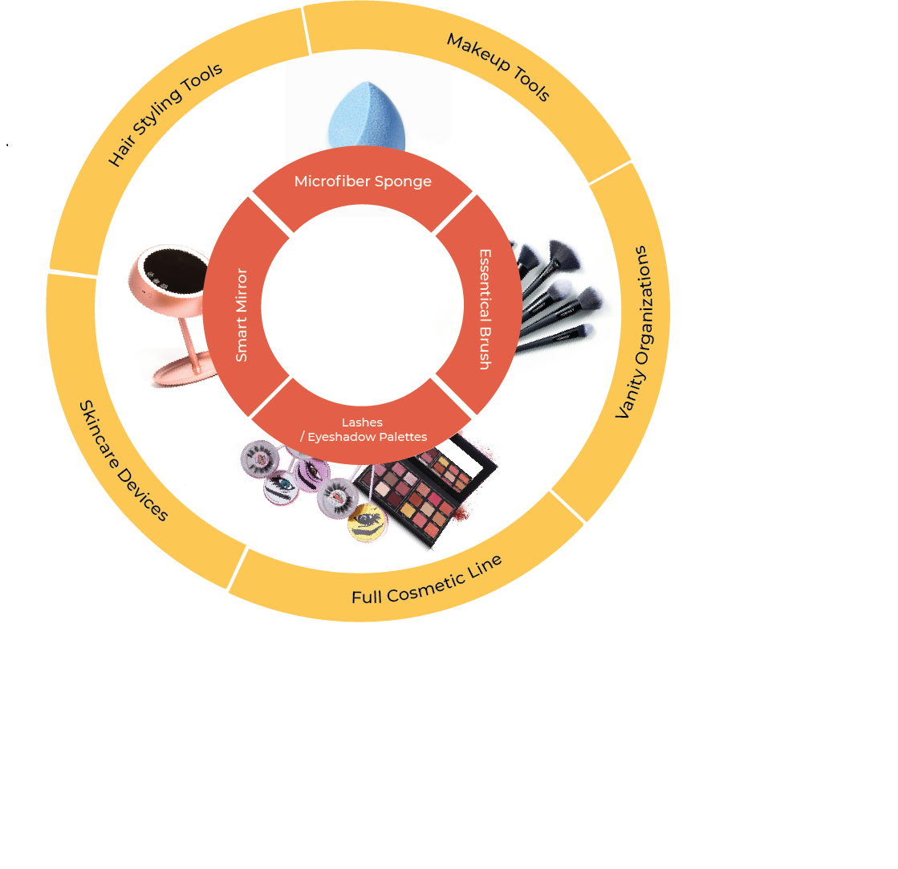
Company Introduction
Location: Burlingame, CA
Mission: to create innovative & quality beauty products at affordable prices
Sales channels: thejuno.co, Amazon, beauty retailers
Main Advertisement: FB/Instagram ads
Designed by JUNO
Notes:
Sponge/Blender：RT - 3000万只
打造JUNO 美妆产品生态圈

Slide 4

Data Set
Data source: JUNO’s FB Ads Manager
Data size: 46 x 5448
Time period: marketing campaigns from July 1, 2018 - February 28, 2019
Key of the Data: campaign_ID, Region, yearfe, monthfe
Each row - metrics of a marketing campaign for a region during a specific month
Important variables:
Campaign Name & Campaign ID
monthfe & yearfe (created, mainly for FE models purpose), Region
amount_spent_USD, Purchases, Reach, Impressions, Frequency, link_clicks, CTR_link, unique_purchases

Slide 5
Project Objectives
Evaluate the metrics and effectiveness of each marketing campaign from July 2018 - February 2019
Segment the regions/states to find out the states to focus on, and the states to avoid
Evaluate the impact of FB ads expense on number of purchases

Slide 6
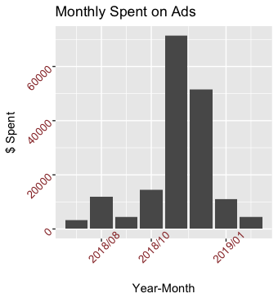
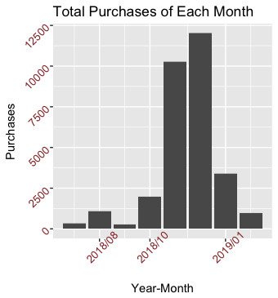


Web Analytics I - Monthly $ Spent on Ad & Monthly Purchases
Notes:
Monthly total purchases
Monthly ad spend

Slide 7
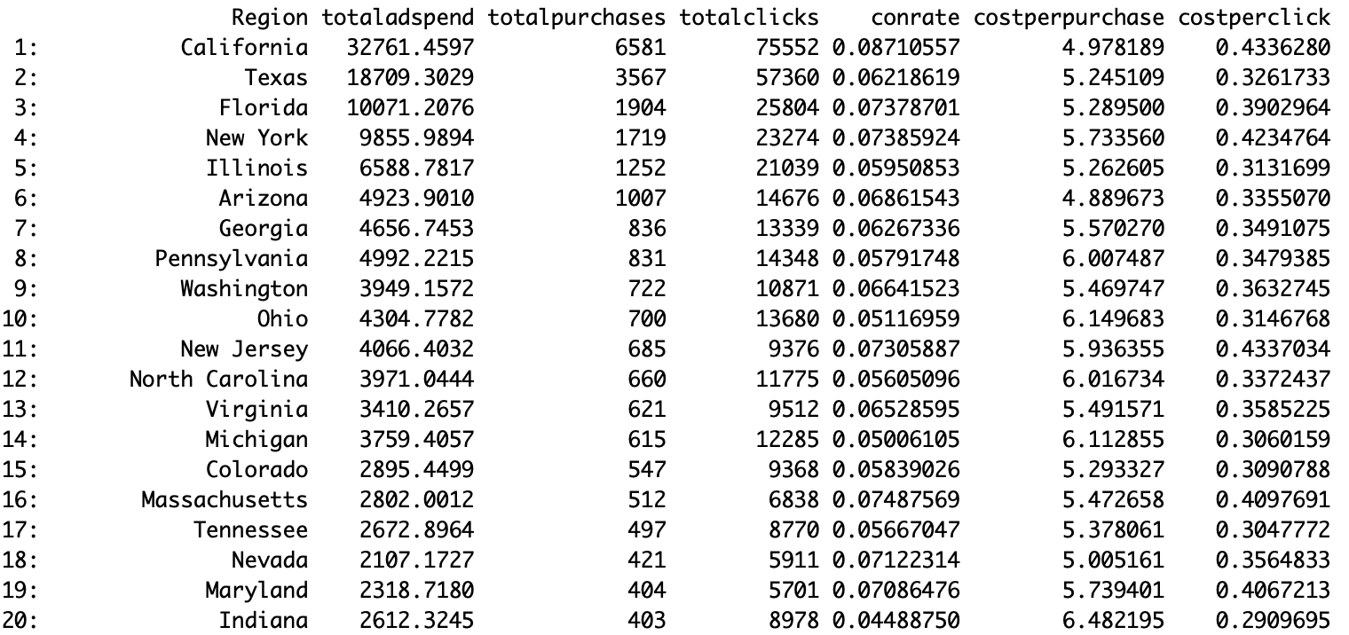
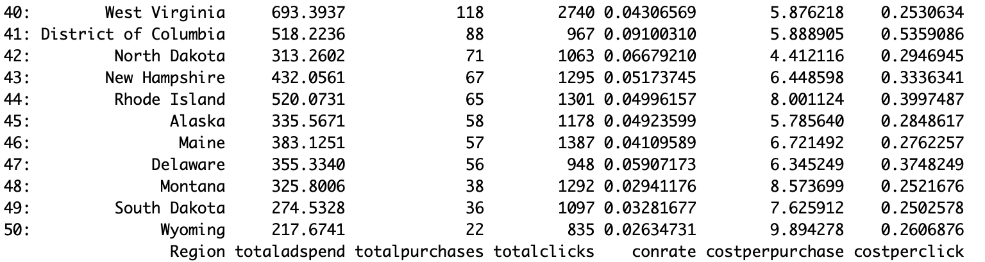
Web Analytics II - Current States Metrics
Top 10 States with the HIGHEST Ad Spend & Total Purchases
Bottom 10 States with the HIGHEST Ad Spend & Total Purchases
?
?
Notes:
Monthly total purchases
Monthly ad spend

Slide 8
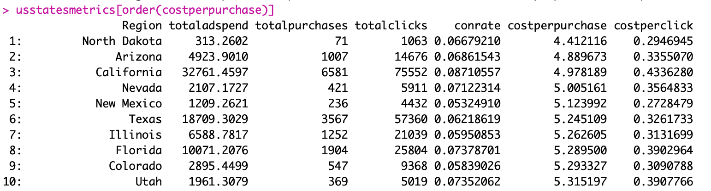
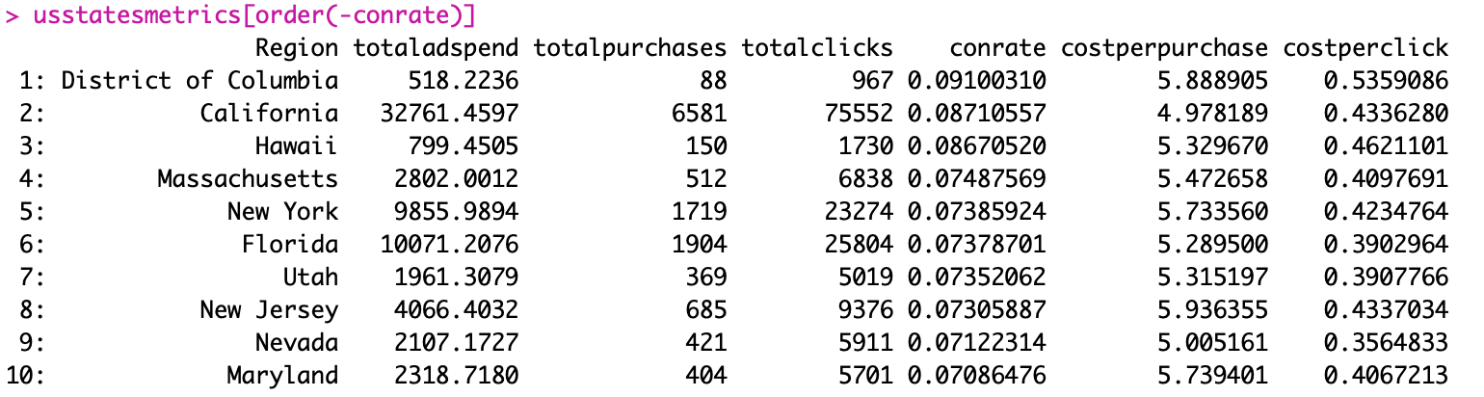
Web Analytics II - States to target
Top 10 States with the LOWEST Ad Cost Per Purchase
Top 10 States with the HIGHEST Ad Conversion Rate
Notes:
Monthly total purchases
Monthly ad spend

Slide 9
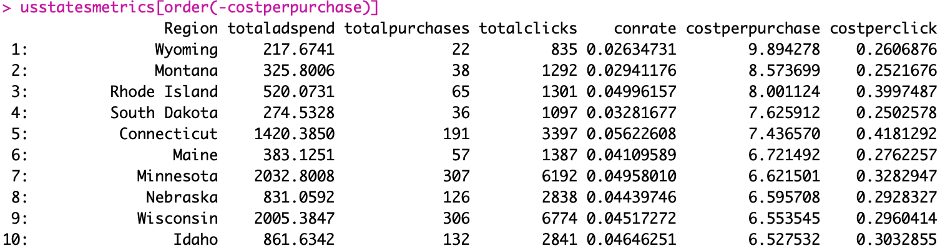
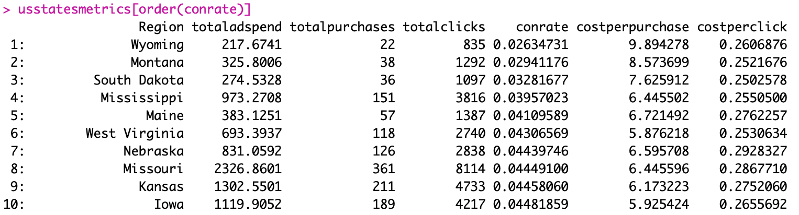
Web Analytics II - States to avoid
Top 10 States with the HIGHEST Ad Cost Per Purchase
Top 10 States with the LOWEST Ad Conversion Rate
Notes:
Monthly total purchases
Monthly ad spend

Slide 10
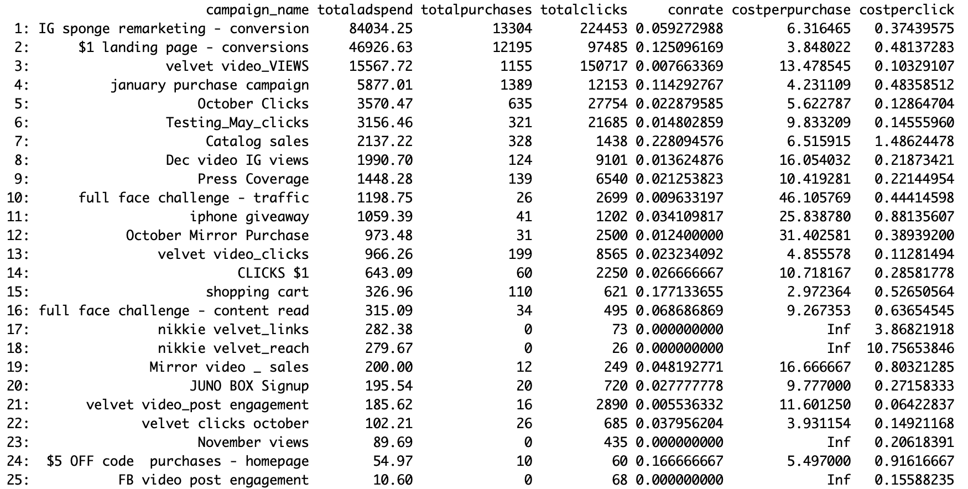
Web Analytics III - Campaigns Metrics
Top 10 Campaigns with the HIGHEST Ad Spend
Notes:
Monthly total purchases
Monthly ad spend

Slide 11
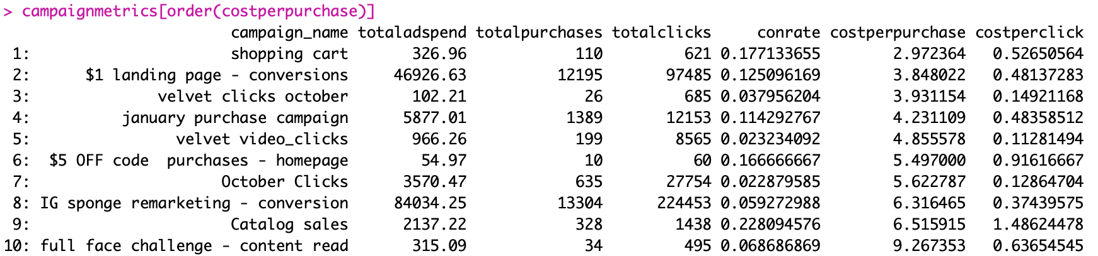
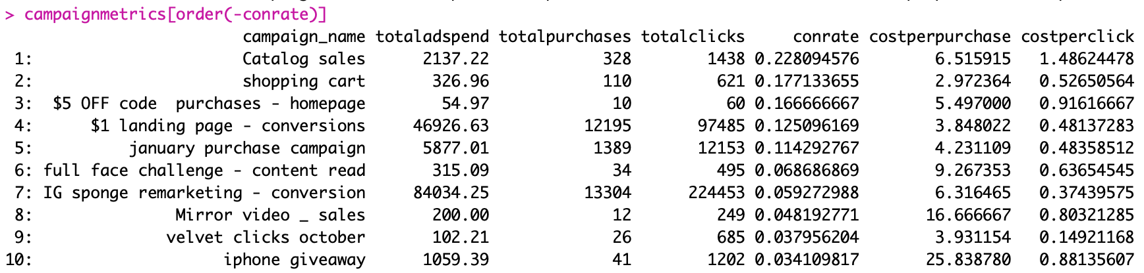
Web Analytics III - Most Successful Campaigns
Top 10 States with the LOWEST Ad Cost Per Purchase
Top 10 Campaigns with the HIGHEST Ad Conversion Rate
Notes:
Monthly total purchases
Monthly ad spend

Slide 12
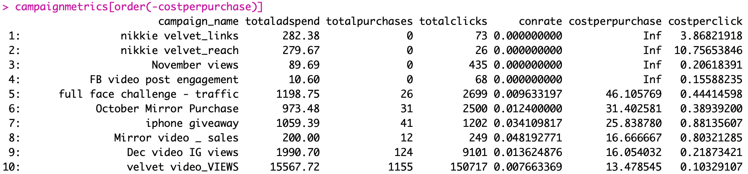
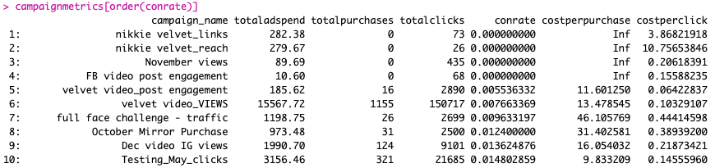
Web Analytics III - Least Successful Campaigns
Top 10 States with the HIGHEST Ad Cost Per Purchase
Top 10 Campaigns with the LOWEST Ad Conversion Rate
Notes:
Monthly total purchases
Monthly ad spend

Slide 13
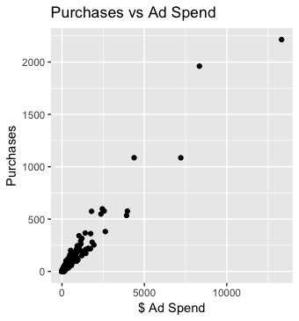
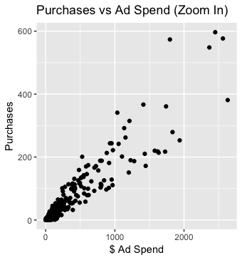
Web Analytics IV- Purchase vs Spend on Ad
Notes:
Monthly total purchases
Monthly ad spend

Slide 14
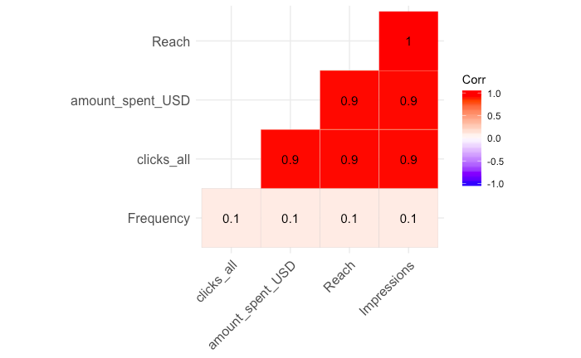
Regression - address Omitted Variables & Multicollinearity
Potential omitted variable bias:
Region difference
Seasonality difference
Campaign difference
Address the OV bias by running fixed effect on Region, Year-Month & Campaign

Slide 15
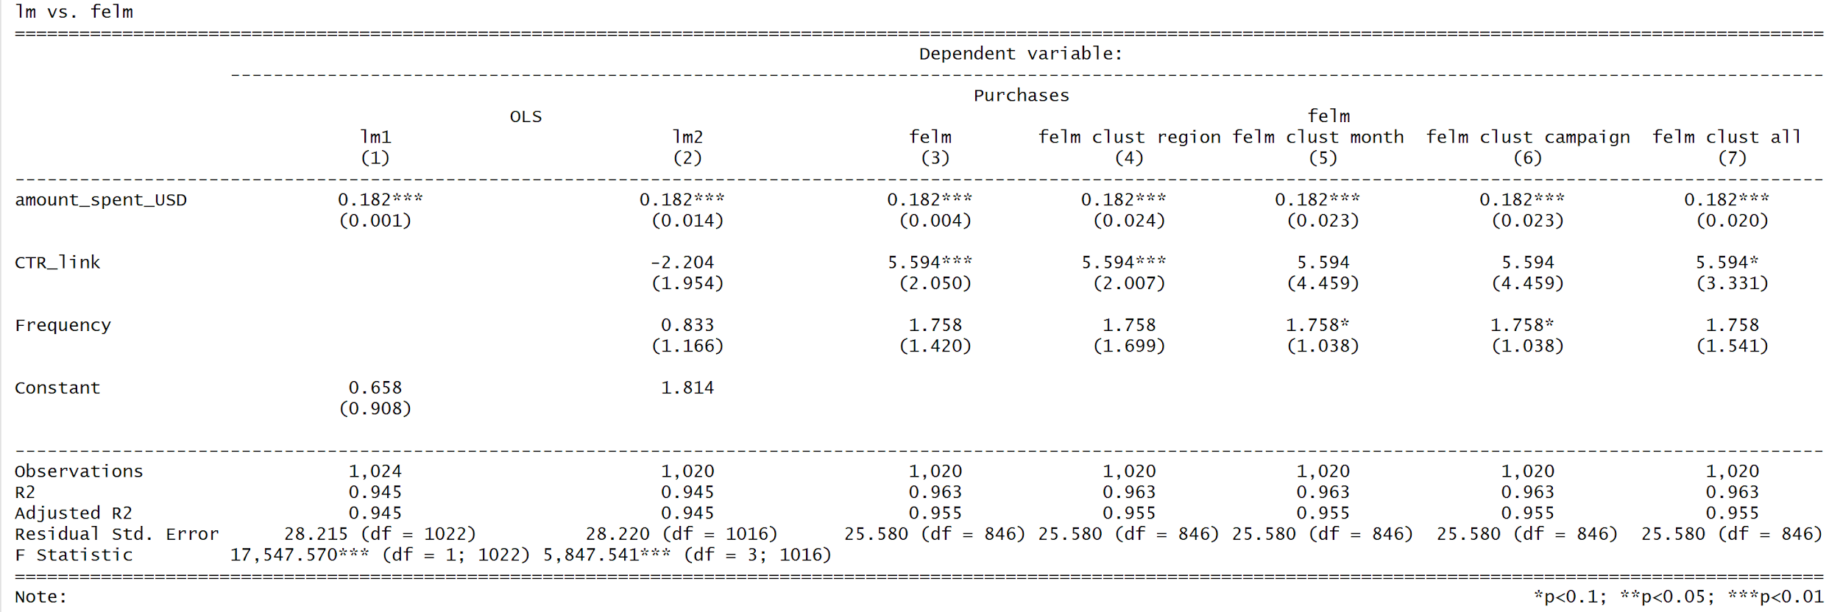
Regression Results

Slide 16
Limitations
Since the company is relatively young (with data only available from July, 2018 - February, 2019), we don’t see trend for the whole year
If we have information on user demographic and interests (individual level data), we can do machine learning algorithms and make predictions
Since the company has a limited market budget, we do not see diminishing returns on ad / saturation
In the early months of the company, the focus could have been ‘Reach’ more customers instead of increasing ‘Purchases’; then the key metric for our analysis could be different

Slide 17
Recommendations & Next Steps
Recommendations to the Company:
Focus on regions with highest conversion rates and lowest cost-per-purchase
Learn from campaigns with highest conversion rates and lowest cost-per-purchase
From regression analysis, we estimate that the company on average to spend 5.5$ on ads for every unit increase in purchase. Comparing this to profit-per-order, the company can determine if it’s profitable to do FB ads
Segment the users by age groups and evaluate
Next Steps in our Analysis:
Run experiments in different regions to verify regression results
Try quadratic term in Regression Analysis

Slide 18
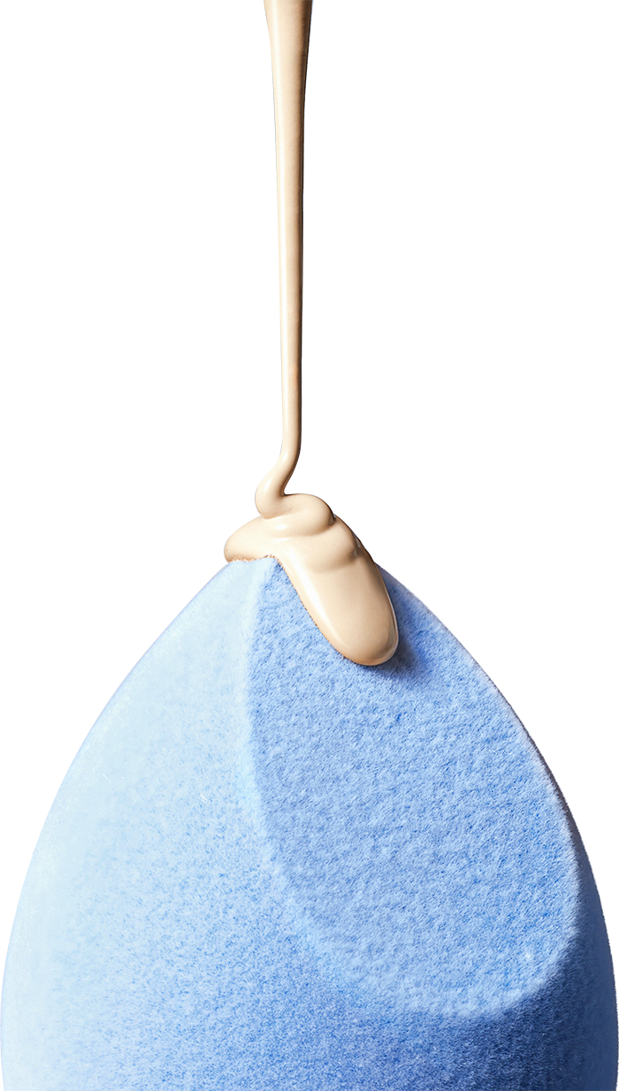
Thank you!

